Slide 1
Java 8 Features

Slide 2
java 7 – July 28th 2011 2 Years
7 Months 18 Days Java
8 - March 18th 2014 Java(Major Version)
9 - September 22nd 2016
Java 10 – 2018

Slide 3
Lambda Expressions
Optional Class
String Joiner
Stream API
Functional Interface
Data and Time Changes API
Method Reference
Constructor Reference
Collection and Framework Changes
Split Iterator
LOSS FD MCCS

Slide 4
Lambda Expressions
The Main Objective of λ Lambda Expression is to bring benefits of functional programming into java.
Lambda Expression is just an anonymous(nameless) function. That means the function which doesn’t have the name,return type and access modifiers. Lambda Expression also known as anonymous functions or closures.

Slide 5
Example
public void m1()
{
System.out.println(“hello”);
}
You can Write
()->
{
System.out.println(“hello”);
}
Or
()-> System.out.println(“hello”);

Slide 6
public void add(inta, int b)
{
System.out.println(a+b);
}
we can Write
(int a, int b) -> sop(a+b);
Or
(a,b) -> sop (a+b);

Slide 7
Functional Interfaces:
if an interface contain only one abstract method, such type of interfaces are called functional interfaces and the method is called functional method or single abstract method(SAM).

Slide 8
Example
1) Runnable → It contains only run() method
2) Comparable → It contains only compareTo() method
3) ActionListener → It contains only actionPerformed()
4) Callable → It contains only call()method

Slide 9
@FunctionalInterface
Interface Interf {
public void m1();
}
@FunctionalInterface
Interface Interf
{
public void m1();
public void m2();
}
@FunctionalInterface
Interface Interf
{
}
Allowed
Not Allowed
Not Allowed

Slide 10
FunctionalInterface with respect to Inheritance:
Case No:1
@FunctionalInterface
interface A {
public void methodOne();
}
@FunctionalInterface
Interface B extends A {
}

Slide 11
@FunctionalInterface
interface A {
public void methodOne();
}
@FunctionalInterface
interface B extends A {
public void methodOne();
}

Slide 12
@FunctionalInterface {
interface A
{
public void methodOne();
}
@FunctionalInterface
interface B extends A {
public void methodTwo();
}

Slide 13
Where we use Functional Interface
Once we write Lambda expressions to invoke it’s functionality, then FunctionalInterface is required. We can use FunctionalInterface reference to refer Lambda Expression. Where ever FunctionalInterface concept is applicable there we can use Lambda Expressions

Slide 14
Without lambda Functional Interface
interface Interf {
public void methodOne()
{
}
public class Demo implements Interface
{
public void methodOne() {
System.out.println( method one execution );
}
public class Test {
public static void main(String[] args) {
Interfi = new Demo();
i.methodOne();
}
}

Slide 15
interface Interf {
public void methodOne()
{
}
class Test {
public static void main(String[] args) {
Interfi = ()
System.out.println(“MethodOne Execution”);
i.methodOne();
}
}

Slide 16
Example:2
Interface Interf {
public void sum(inta,int b);
}
class Demo implements Interf {
public void sum(inta,int b) {
System.out.println(“The sum:” +(a+b));
}
}
public class Test {
public static void main(String[] args) {
Interfi = new Demo();
i.sum(20,5);
}
}

Slide 17
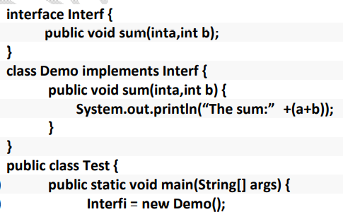
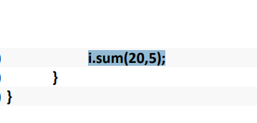
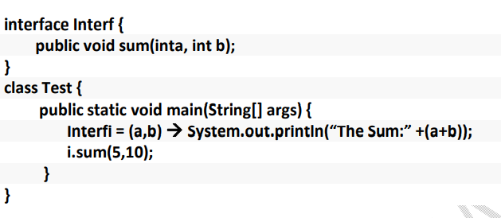

Slide 18
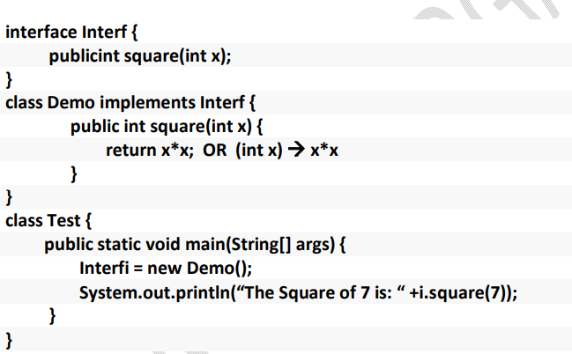
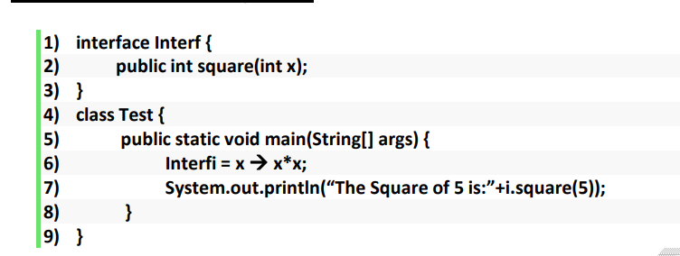

Slide 19
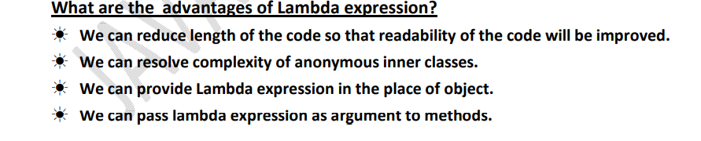

Slide 20
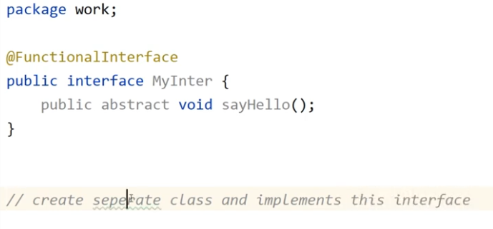
Examples

Slide 21
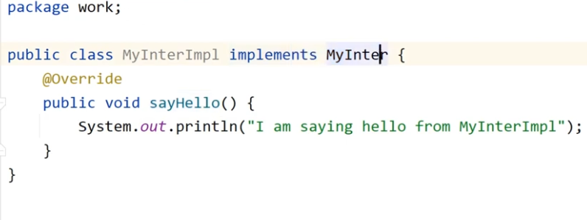

Slide 22
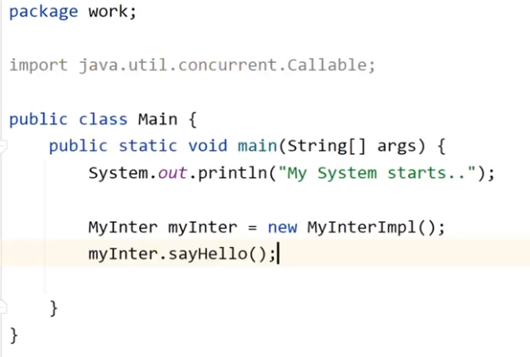

Slide 23
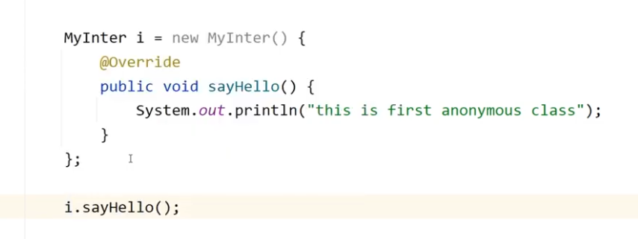
Anonymous class

Slide 24
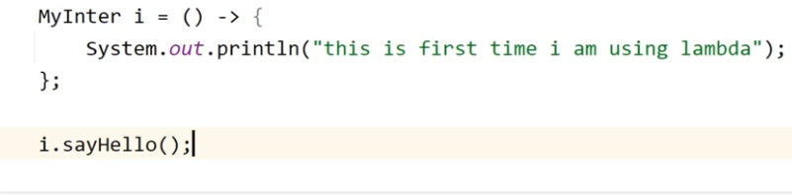
Lambda Expression

Slide 25
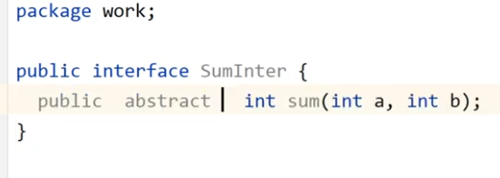
Example 2

Slide 26
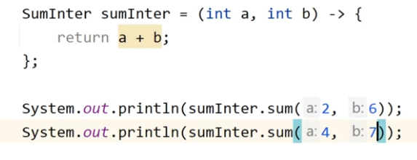

Slide 27
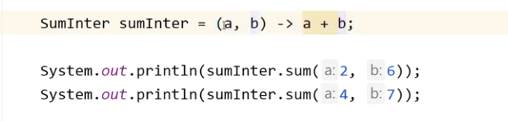
We can also write

Slide 28
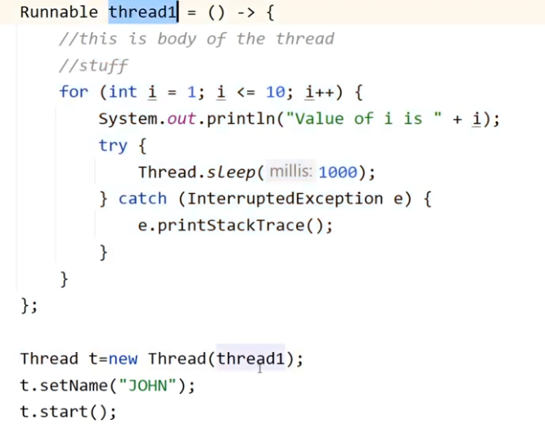
Example3 Runnable Interface

Slide 29
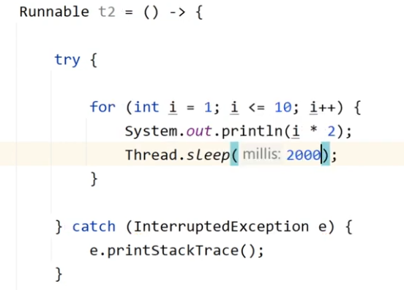
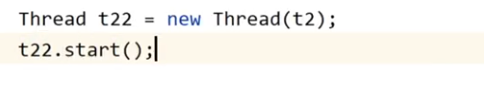
Example 3

Slide 30
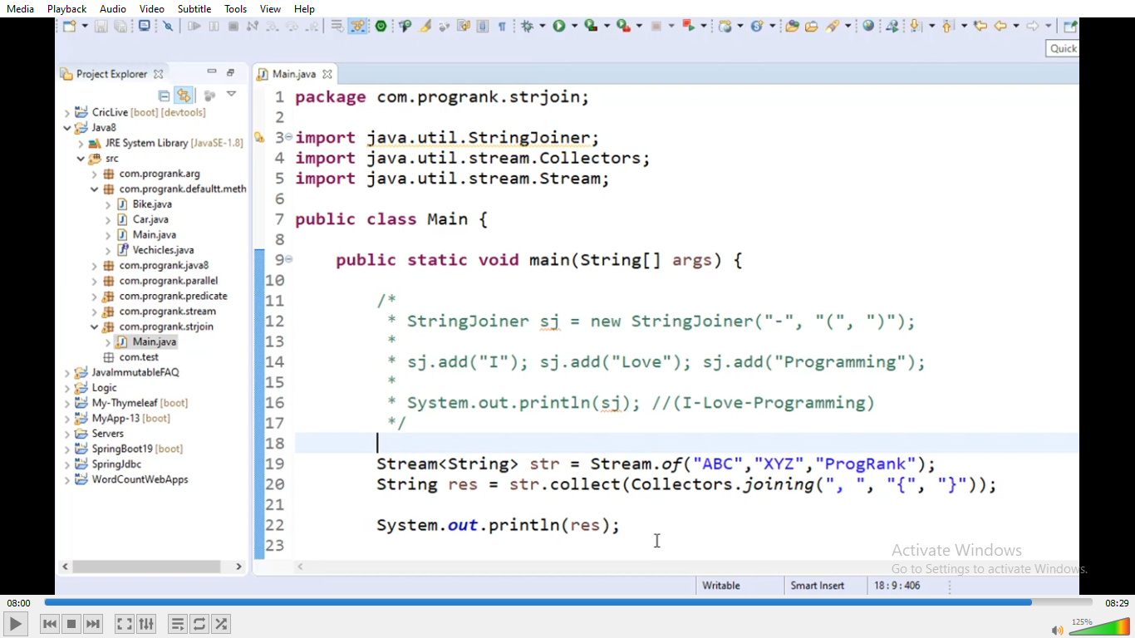
String Joinners

Slide 31
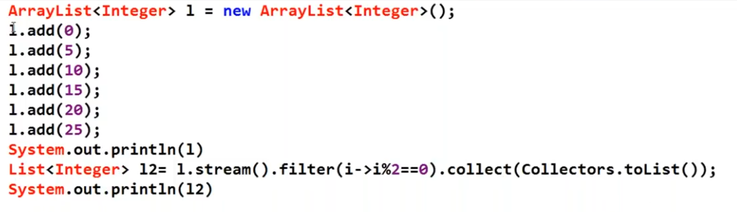
Stream API

Slide 32
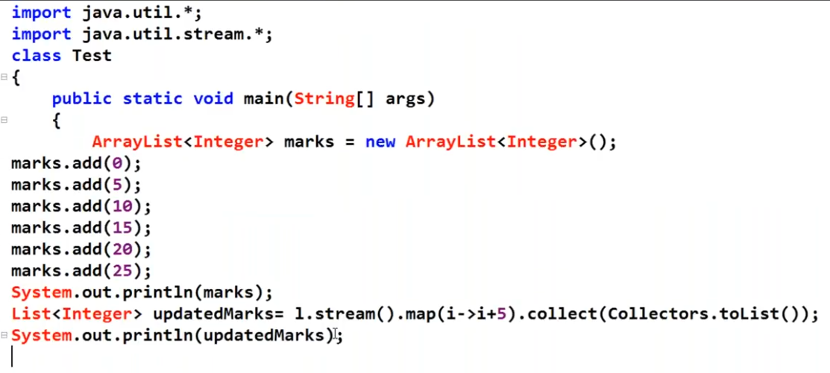

Slide 33
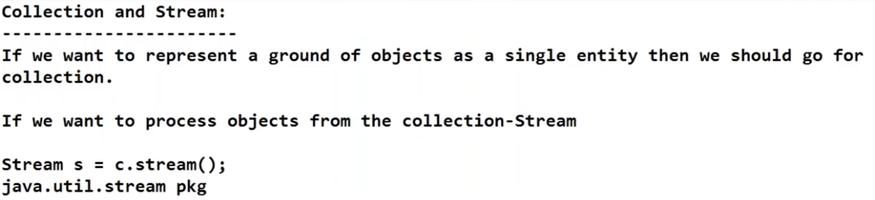

Slide 34
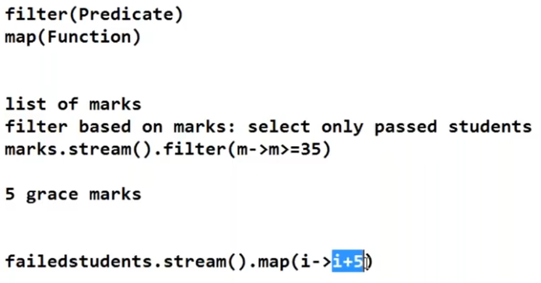

Slide 35
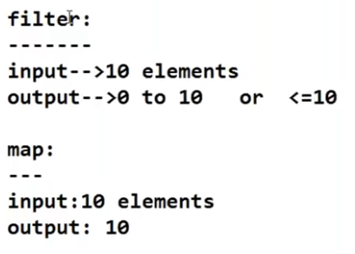

Slide 36
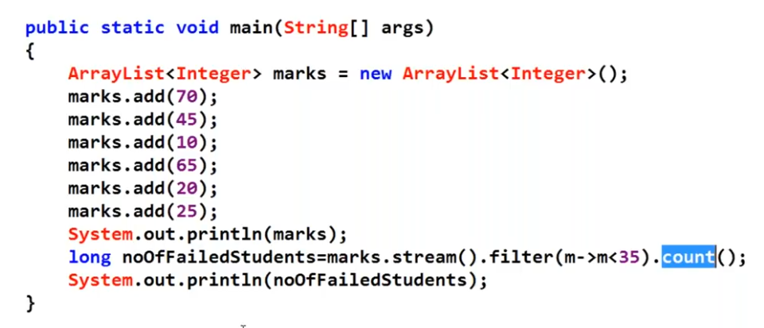

Slide 37
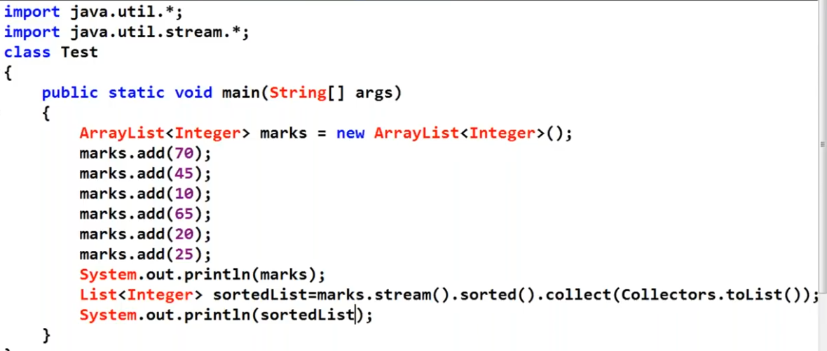

Slide 38
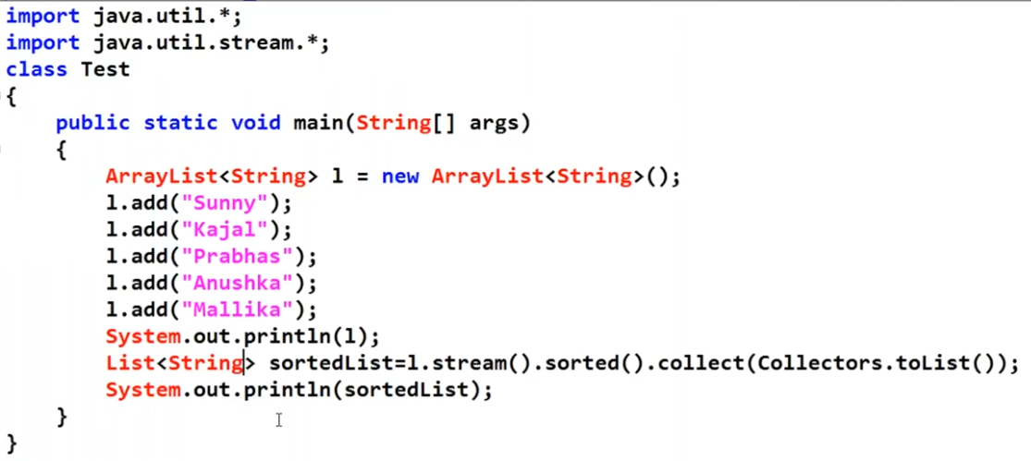

Slide 39
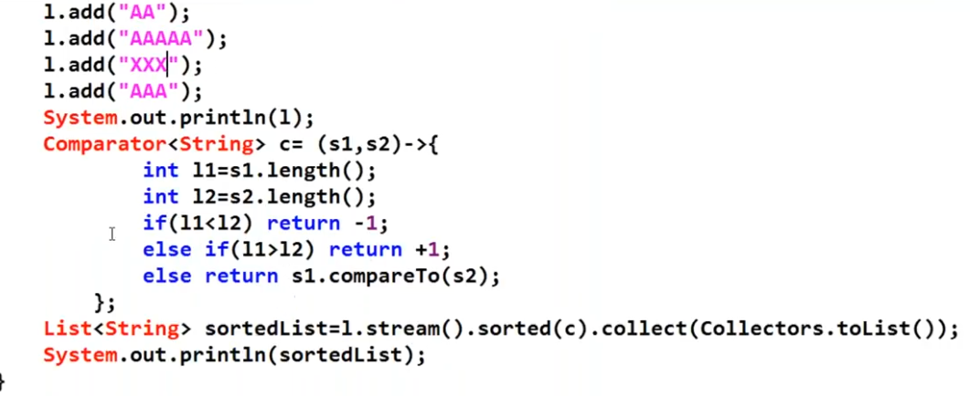

Slide 40
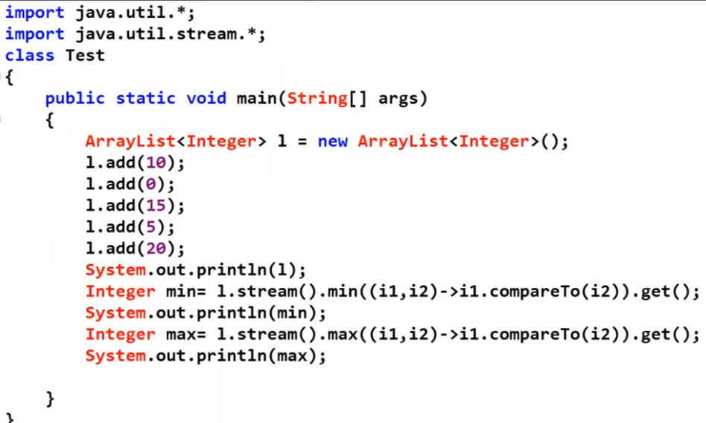

Slide 41
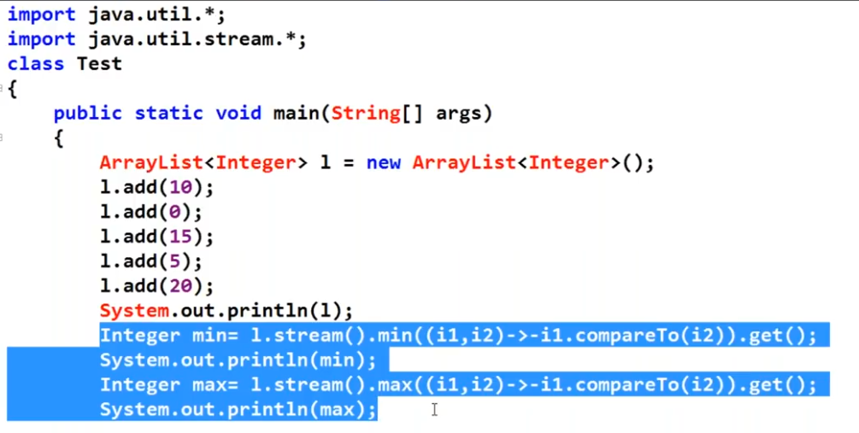

Slide 42
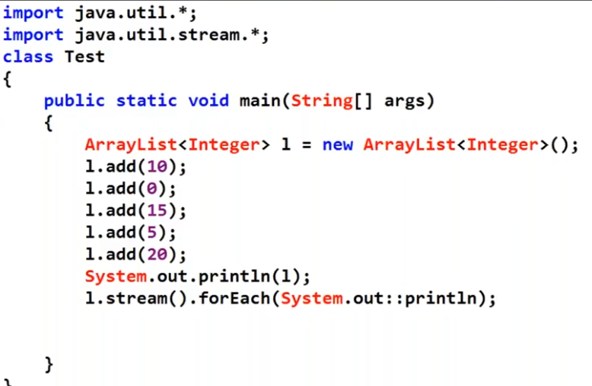

Slide 43
Pre define functions interface

Slide 44
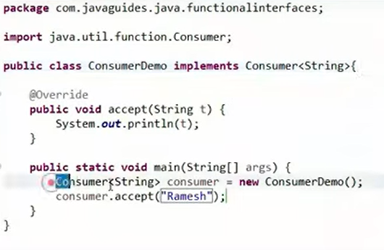
Consumer functional interface

Slide 45
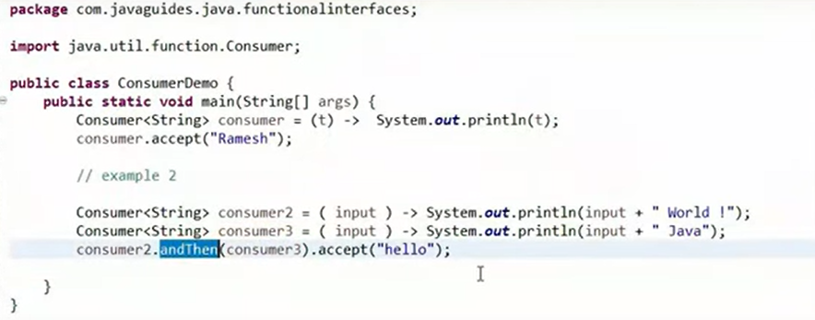

Slide 46
